Slide 1
Lecture 2: conceptualization of the family
SC22o5: Sociology of the family

Slide 2
Last week
Social construction of the family
The official definition of the family
Family as a social institution
Family as a cultural symbol
Historical and societal developments
Should or can we go beyond the official definition of the family?

Slide 3
outline
Family ideology
Conceptualization of family ideology
Context of family ideology
Elements of family ideology

Slide 4
Conceptualization of family ideology
Total conception of ideology
An orientation that characterizes the thinking of an era or group
Our traditional family model of the married heterosexual couple with children – based on a sexual division of labor where the husband as breadwinner provides economic support for his dependent wife and children, while the wife cares for both the husband and children
Particular conception of ideology
Resistance to the dominant orientation
For example, single-parent families, widowed parents, and unmarried mothers

Slide 5
Conceptualization of family ideology
Ideology
As a set of ideas
Our traditional family model of the married heterosexual couple with children – based on a sexual division of labor where the husband as breadwinner provides economic support for his dependent wife and children, while the wife cares for both the husband and children
Ideology
As lived experience
Increasing divorce rates
Rising proportion of single-parent households
Lifelong marriage as one of the several alternatives

Slide 6
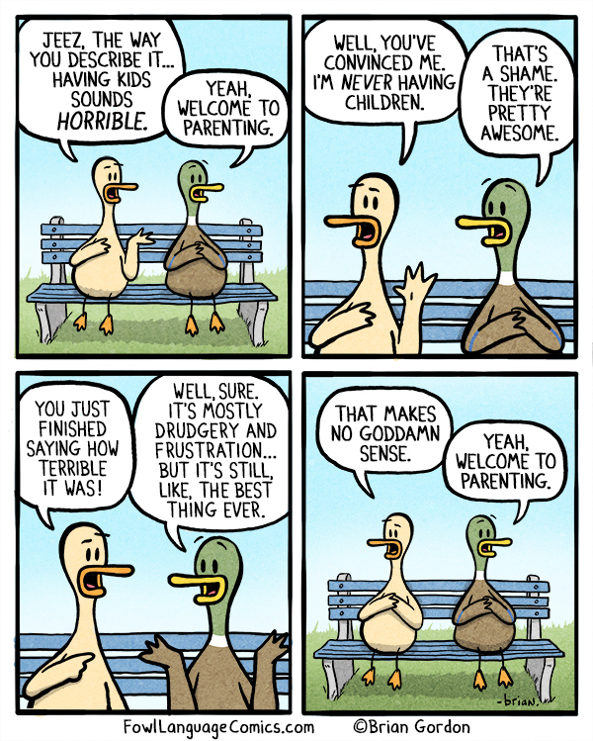
Conceptualization of family ideology
Ideology as a single unitary social reality
We do not simply reproduce ideology
Ideology as multiple realities
We negotiate its meaning
For example, single parents redefine the family in terms of functional characteristics rather than structural characteristics

Slide 7
Context of family ideology
Family ideology
Gender ideology
Wage labor ideology

Slide 8
The Singapore Context
Women are encouraged to bear more children (gender ideology)
To survive in an economically competitive world (wage labor ideology)
But only in the capacity of a wife attached to a husband (family ideology)

Slide 9
Elements of family ideology
Individualistic mode of thought
Naturalistic analysis of human behavior
Major forms of differentiation
Idolistic mystification of human social life

Slide 10
Elements of family ideology
“I” and “self”
A just born infant is completely unaware of self
The infant begins to recognize that he or she is a separate entity only when others act toward the infant in a manner that is distinct from the way they act toward other individuals and objects (individualist element)
The emergence of self is a first step in socialization

Slide 11
Elements of family ideology
Socialization
Teaches basics of life in society
Transmits skills important to survival in society
Instills desire to work toward goals society considers important
Provides identity
Teaches fulfillment of social roles

Slide 12
Elements of family ideology
The process of socialization functions to the advantage of both society and the individual
Society profits because each new generation learns how to behave as a member of it
The individual profits because he or she acquires a self and a unique personality (element of differentiation)

Slide 13
Elements of family ideology
The process of socialization continues throughout an individual’s lifetime
Children must learn to develop values, attitudes, and behaviors that are in accordance with the aims of their society
Adults must learn new roles as they enter the labor force or as they change their statuses

Slide 14
Elements of family ideology
Women’s mothering
Women are socialized to take primary responsibility for infant care, spend more time with infants and children than do men, and sustain primary emotional ties with infants
When biological mothers do not parent, other women, rather than men, always take their place

Slide 15
Elements of family ideology
Women’s mothering as a universal and enduring element of the sexual division of labor
The “natural” connection between women’s childbearing and lactation capacities and their responsibility for childcare (naturalistic element)
Today, the actual biological and physical requirements of childbearing and childcare have decreased
But women’s mothering role has gained psychological and ideological significance and has come increasingly to define women’s lives (element of idolistic mystification)

Slide 16
Elements of family ideology
In the eighteenth and nineteenth centuries, the household was the major productive unit of society
Although marriage and adulthood was previously coextensive with childrearing, mothering did not dominate women’s lives
A woman carried out her childcare responsibilities along with a range of other productive work
Husband and wife, with their children, were a cooperative producing unit

Slide 17
Elements of family ideology
Development of capitalism and corresponding industrialization
Production outside the home expanded greatly, while production within the home declined
Household necessities became commodities mass-produced in factories
Production outside the home became identified with work and the home was no longer viewed as the workplace
Home and workplace, once the same, are now separate

Slide 18
Elements of family ideology
The private sphere of the family
This change in the organization of production produced extensive changes in family and in women’s lives
The family became a relational and personal institution
Women’s family role became centered on childcare and taking care of men

Slide 19
Elements of family ideology
The private sphere of the family
Women’s mothering more isolated and exclusive
For example, single fathers view remarriage as a “necessity” while single mothers view remarriage as “nearly impossible” and “burdensome”
The “normal family” as a reference point for single parents

Slide 20
Elements of family ideology
Women’s emotional role
Women’s biological and economic roles

Slide 21
Nature, pervasiveness and power of family ideology
Family ideology is a multifaceted system of ideas and practices that reinforce the “normal family” as natural and universal
Family ideology interacts gender ideology and wage labor ideology such that women in “normal family” situations are expected to be nurturers of future generations as well as laborers contributing to the progress of the national economy
Family ideology presents a representation of the family that is distinct from the reality of the family

